Slide 1

Vel Tech Rangarajan Dr. Sagunthala R&D Institute of Science and Technology
School of Computing
Department of Computer Science and Engineering
10211CS224 / FULL STACK APPLICATION DEVELOPMENT (JAVA)
END SEMESTER PROJECT REVIEW
Date: 06-05-2026
Design and develop a modern, clean, and responsive React JS web application for Ticket Booking of an Internal Department Event.
SDG: 9-Industry,Innovation and Infrastructure
Presented By:
K.SanjeevReddy– VTU25537 – 23UECS0264
Courses Handling Faculty: Dr.MAGESHWARI.M-M.E,Ph.D.

Slide 2
INTRODUCTION
1
The system is a web-based ticket booking application for internal department events.
It simplifies and digitizes the process of reserving event tickets.
The application reduces manual errors and saves time in event registration.
It is developed using React JS for building a dynamic and responsive user interface.
The system provides features like event listing, ticket selection, and booking confirmation.
The application ensures a modern, clean design and works smoothly across all devices.
2
3
4
5
6
7
8
9

Slide 3
PROBLEM STATEMENT
1
Many departments still use manual or semi-automated systems for event ticket booking. Lack of a centralized system for managing event registrations.
High chances of human errors like duplicate or incorrect entries.
No real-time tracking of ticket availability.
Poor user experience due to outdated or non-responsive methods.
Difficulty in handling large numbers of registrations.
Lack of secure storage and management of user data.
No proper system for booking confirmation or receipt generation.
Limited accessibility across different devices and platforms.
2
3
4
5
6
7
8
9

Slide 4
OBJECTIVE(S)
1
To develop a modern and responsive web application for ticket booking.
To simplify and automate the event registration process.
To provide a user-friendly interface for easy navigation and booking.
To ensure real-time ticket availability and booking updates.
To reduce manual errors and improve data accuracy.
To allow efficient management of event details and bookings.
To ensure accessibility across multiple devices and screen sizes.
To provide instant booking confirmation to users.
2
3
4
5
6
7
8
9

Slide 5
PROPOSED SYSTEM
1
The proposed system is a web-based ticket booking application developed using React JS.
It provides a centralized platform for managing internal department event registrations.
The system allows users to view event details and book tickets online
It offers real-time ticket availability and instant booking confirmation.
The application features a clean, modern, and responsive user interface.
It ensures secure handling and storage of user and booking data.
The system reduces manual work and minimizes human errors.
It supports efficient management of events, users, and bookings.
2
3
4
5
6
7
8
9

Slide 6
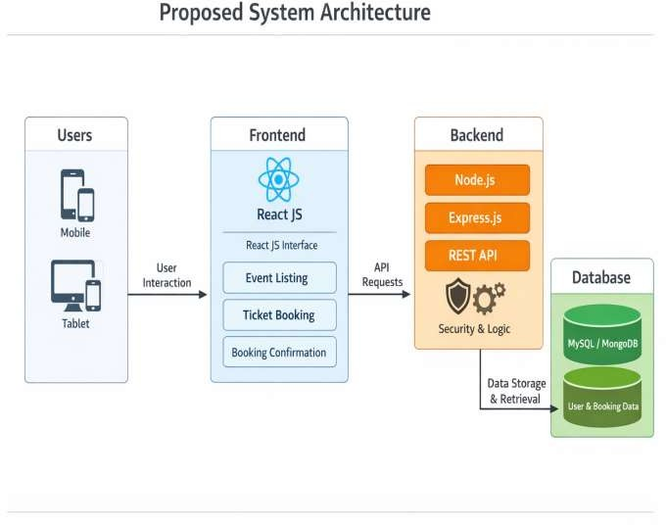
PROPOSED SYSTEM ARCHITECTURE
1
Users interact with the application through a web browser or mobile device.
The frontend is developed using React JS for a responsive user interface.
The backend handles business logic and processes user requests.
APIs are used for communication between frontend and backend.
The database (MySQL) stores user, event, and booking data.
The system provides real-time data processing and updates.
Secure data handling and input validation are implemented.
The architecture supports scalability and multiple users.
The system consists of user, frontend, backend, and database layers.
Data flows from user → frontend → backend → database and back
2
3
4
5
6
7
8
9

Slide 7
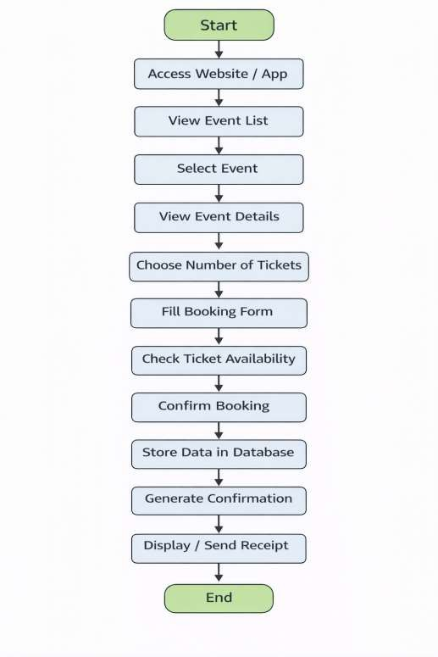
WORKFLOW
1
The workflow of the ticket booking system begins when the user accesses the web application through a browser or mobile device. The system displays a list of available events, allowing the user to
2
browse and select a preferred event. Once selected, detailed
3
information about the event such as date, time, and venue is presented.
The user then proceeds to choose the number of tickets required and fills in the booking form with necessary details like name and contact information. After submitting the form, the system checks the availability of tickets in real-time to ensure accurate booking.
If tickets are available, the system confirms the booking and stores the user and booking details in the database. Following this, a confirmation is generated, and a receipt is displayed or sent to the user via email. Finally, the process ends with the successful completion of the ticket booking, and the user can later view or manage their bookings if needed.
4
5
6
7
8
9

Slide 8
TECHNOLOGIES USED
React JS – Used to build a dynamic, responsive, and interactive user interface.
HTML5 – Provides the basic structure of the web application.
CSS3 – Used for styling and designing a clean and modern layout.
JavaScript – Handles client-side logic and user interactions.
Node.js – Used for backend development and server-side processing.
Express.js – Framework used to build RESTful APIs and manage server routes.
MySQL – Database used to store user, event, and booking information.
REST API – Enables communication between frontend and backend.
Git & GitHub – Used for version control and project management.
VS Code – Development environment used to write and manage code.
1
2
3
4
5
6
7
8
9

Slide 9
MODULE DESCRIPTION
User Module
This module manages user-related functionalities such as registration, login, and profile management. It ensures that only authenticated users can access the booking system
Event Module
The event module is responsible for creating, updating, and displaying event information. It includes details like event name, date, time, venue, and available tickets
Booking Module
This module handles the complete ticket booking process. Users can select the number of tickets, enter required details, and confirm their booking. It checks ticket availability, processes the request, and generates booking confirmation after successful completion.
Admin Module
The admin module provides control to manage the entire system. Administrators can add or modify events, monitor bookings, and manage users. It helps in maintaining the system efficiently and ensures smooth operation of the application.
1
2
3
4
5
6
7
8
9

Slide 10
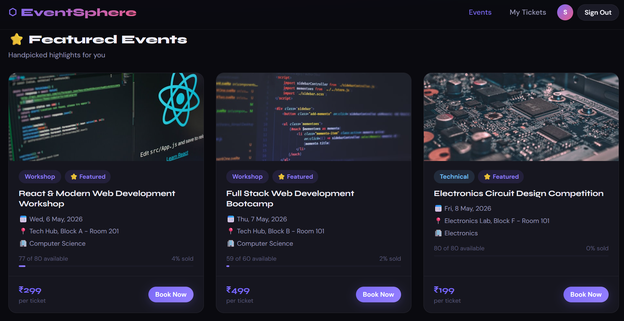
IMPLEMENTATION SCREENSHOTS
1
Home page :
The home page displays key event details like name, date, time, and venue in a clear and attractive layout.
It provides a “Book Now” button for quick and easy ticket booking.
2
3
4
5
6
7
8
9

Slide 11
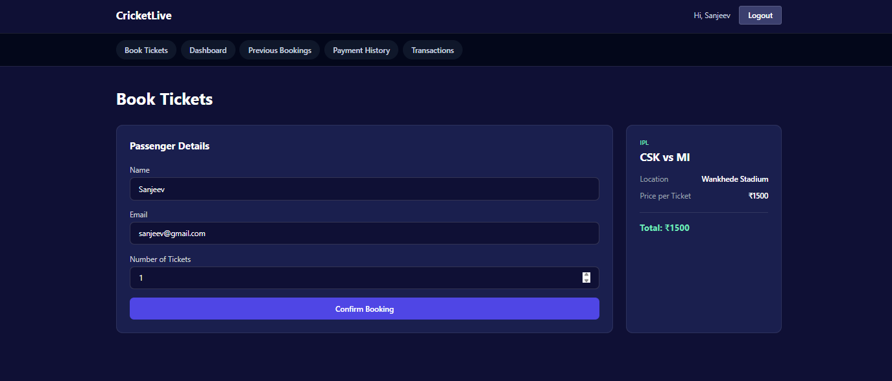
IMPLEMENTATION SCREENSHOTS
Ticket Booking Page :
1
It provides a simple and user-friendly interface to complete the ticket booking process efficiently.
The form ensures proper data input and helps in accurate booking and record management.
.
2
3
4
5
6
7
8(A)
9

Slide 12
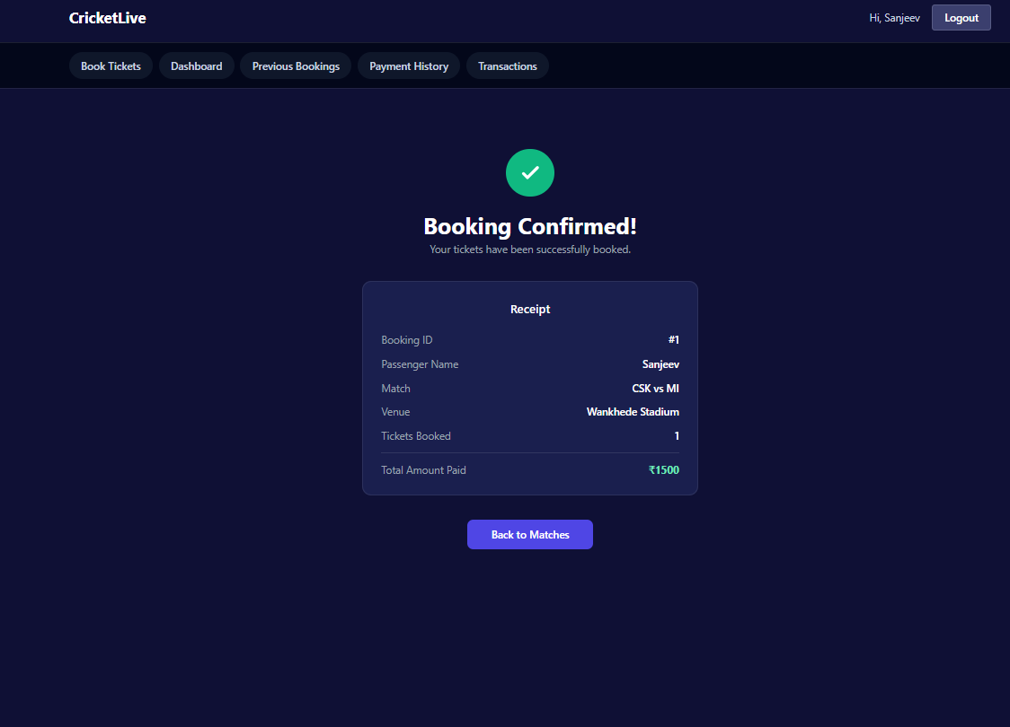
IMPLEMENTATION SCREENSHOTS
This page displays the booking confirmation status, indicating that the ticket has been successfully booked.
It shows complete booking details such as user information, event name, number of tickets, date, and a unique booking ID.
It also provides a confirmation message and an option to return to the home page.
1
2
3
4
5
6
7
8(B)
9

Slide 13
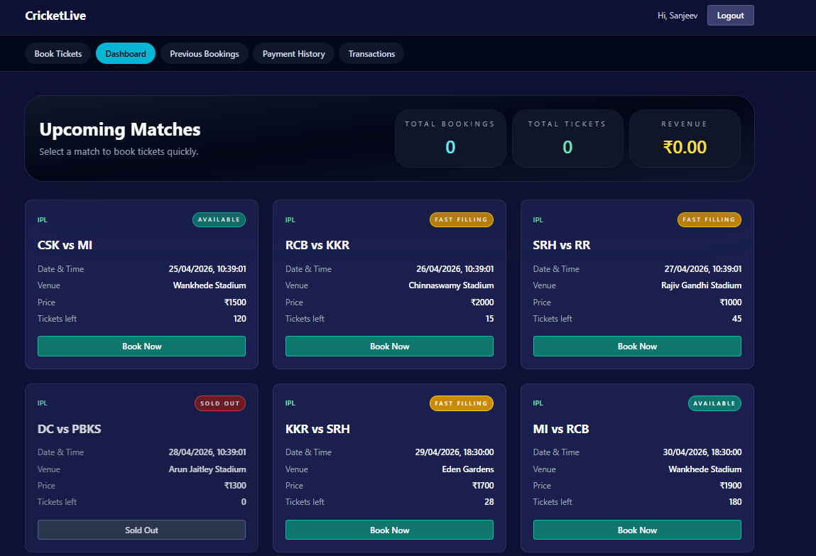
IMPLEMENTATION SCREENSHOTS
Output Page (Live Dashboard) :
1
2
The admin dashboard provides an overview of all booking activities, including total bookings, total tickets, and top-performing department.
It displays detailed booking records such as booking ID, user name, email, department, number of tickets, and date in a structured table format.
The dashboard includes a search feature to quickly find and manage specific bookings.
3
4
5
6
7
8(C)
9

Slide 14
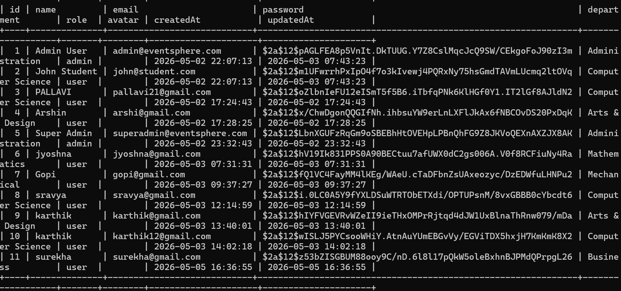
IMPLEMENTATION SCREENSHOTS
Database Screenshot
The users table stores essential details such as name, email, encrypted password, department, and role (admin/user).
It helps manage authentication and authorization for both participants and administrators in the ticket booking system.

Slide 15
ADVANTAGES & LIMITATIONS
Advantages :
1
Provides a fast and easy ticket booking process.
Reduces manual work and minimizes human errors.
Offers real-time ticket availability and instant confirmation.
User-friendly and responsive design for all devices.
Centralized system for managing events and bookings.
Enables easy tracking and management of booking records.
Limitations :
2
3
4
5
6
Requires internet connection to access the system.
Dependent on server performance and availability.
Limited features if payment integration is not included.
Data security risks if not properly implemented.
Initial setup and development require technical expertise.
System maintenance and updates are needed regularly.
7
8
9

Slide 16
Thank you

